Slide 1

Reporting and Analyzing Current Liabilities
9
Chapter
UAA – ACCT 201 Principles of Financial Accounting Dr. Fred Barbee

Slide 2
IS FUN!
ACCT 201
Chapter 9
Day 2

Slide 3
Problem 9-2A is due
Today!

Slide 4
ACCT 201 ACCT 201 ACCT 201
Chapter 9 - Day 2
Topic | LO | Read | HW
Estimated Liabilities | P4 | 386-389 | QS7, 8; E8, 9
Contingent Liabilities | C3 | 390-391 | QS10, E2
Long-Term Liabilities | None | 391-392 | None
Decision Analysis | A1 | 392-393 | E10, P3A
Agenda
ACCT 201 ACCT 201 ACCT 201

Slide 5
Reporting and Analyzing Current Liabilities
9
Chapter
Estimated Liabilities

Slide 6

Estimated Liabilities
An estimated liability is a known obligation of an uncertain amount, but one that can be reasonably estimated.
Notes:
5
73

Slide 7
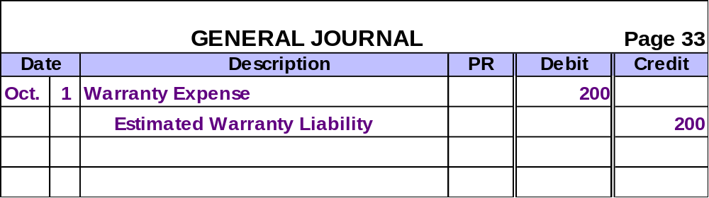
Estimated Liabilities
On October 1, a dealer sold a car with a 12-month warranty. Past experience indicates that the average warranty expense for this car is $200.
The dealer would prepare the following entry on October 1.
ACCT 201 ACCT 201 ACCT 201
Notes:
5
73

Slide 8
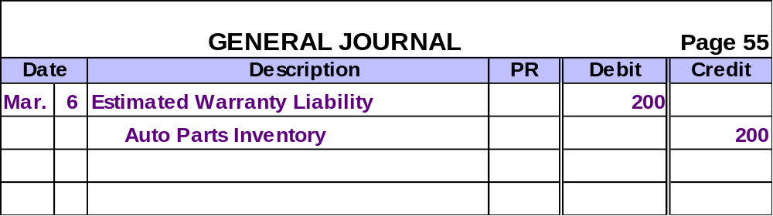
Estimated Liabilities
On March 6, the customer brings the car in for $200 of repairs.
The dealer would make the following entry.
ACCT 201 ACCT 201 ACCT 201
Notes:
5
73

Slide 9
Other Estimated Liabilities
Employer expenses for pensions or medical, dental, life and disability insurance
Employee Health and Pension Benefits
Employer expenses for paid vacation by employees
Vacation
Pay
ACCT 201 ACCT 201 ACCT 201
Notes:
5
73

Slide 10

Income Tax Liabilities
Corporations pay income taxes quarterly.
Notes:
5
73

Slide 11

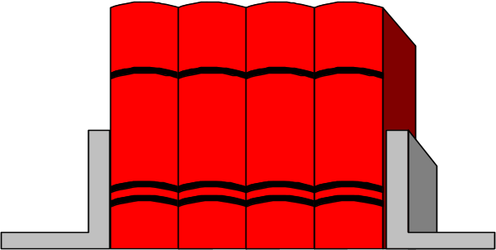
Deferred Income Tax Liability
Determined by applying measurement rules established by Internal Revenue Service.
Taxable Income
Determined by applying Generally Accepted Accounting Principles (GAAP).
GAAP
GAAP
GAAP
GAAP
GAAP Income
ACCT 201 ACCT 201 ACCT 201
Notes:
5
73

Slide 12
Deferred Income Tax Liability
≠
GAAP
GAAP
GAAP
GAAP
GAAP Income
Taxable Income
The difference between taxable income and financial statement income results in temporary differences.
ACCT 201 ACCT 201 ACCT 201
Notes:
5
73

Slide 13
Reporting and Analyzing Current Liabilities
9
Chapter
Contingent Liabilities

Slide 14
Contingent Liabilities
Potential obligation depends on a future event arising out of a past transaction or event.
Probable
Reasonably Possible
Remote
Amount Estimable
Record Contingent Liability
Disclose Liability in Notes
No Action
Amount Not Estimable
Disclose Liability in Notes
Disclose Liability in Notes
No Action
ACCT 201 ACCT 201 ACCT 201

Slide 15
Reporting and Analyzing Current Liabilities
9
Chapter
Long-Term Liabilities

Slide 16
Long-Term Liabilities
Known
Long-Term Liabilities
Known obligations of a business such as unearned revenue and notes payable.
Estimated Long-Term Liabilities
Noncurrent portion of employee benefits, warranties, deferred income taxes, etc.
Noncurrent portion of debt related to litigation, debt guarantees, environmental assessments, etc.
Contingent Long-Term Liabilities
ACCT 201 ACCT 201 ACCT 201
Notes:
5
73

Slide 17
Reporting and Analyzing Current Liabilities
9
Chapter
Decision Analysis

Slide 18
Exh.
9.7
Times Interest Earned
Income Before Interest Expense and Income Taxes
Times Interest Earned =
Interest Expense
If income before interest varies greatly from year to year, fixed interest charges can increase the risk that an owner will not earn a positive return and be unable to pay interest charges.
When this ratio falls below 1.5 and remains at that level or lower for several periods, the default rate on liabilities increases sharply.
ACCT 201 ACCT 201 ACCT 201
Notes:
5
73

